Slide 1
Presidents by ratings
Brandy Davis & Rebecca leu

Slide 2
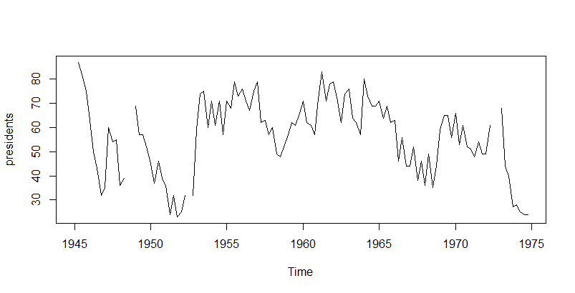
Introduction to Presidents dataset
Quarterly approval ratings from 1945 to 1974
Presidents during this time:
Harry S Truman
Dwight D Eisenhower
John F Kennedy
Lyndon B Johnson
Richard M Nixon

Slide 3
Questions to be answered
Are there any differences in the mean approval ratings between Republican and Democratic presidents?
Do “wartime” presidents typically have higher or lower approval ratings?
Are the ratings of presidents time predictable, and if so, to what degree?

Slide 4
Making subsets of the data
HST<-presidents[c(2:32)] #Harry S Truman
DDE<-presidents[c(33:64)] # Dwight D Eisenhower
JFK<-presidents[c(65:76)] #John F Kennedy
LBJ<-presidents[c(77:96)] #Lyndon B Johnson
RMN<-presidents[c(97:119)] #Richard M Nixon
Republican<-c(DDE,RMN)
Democrat<-c(HST,JFK,LBJ)
WWII<-presidents[c(1:4)] #WWII
KWar<-presidents[c(22:35)] #Korean War
VWar<-presidents[c(79:113)] #Vietnam War
WARTIME<-c(WWII, KWar, VWar)
NonWARTIME <-presidents[c(5:21, 36:78, 114:119)]

Slide 5
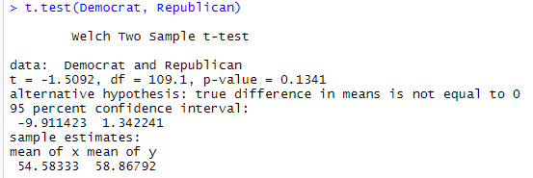
Are there any differences in the mean approval ratings between Republican and Democratic presidents?
Null: H0; Republican and democrats have the same mean rating
Alternative: H1; Republicans and democrats do not have the same mean ratings
Conclusion: Failure to reject the null hypothesis and accept the alternative that there is a difference in the mean ratings between democrats and republicans, but the data is not very significant.

Slide 6
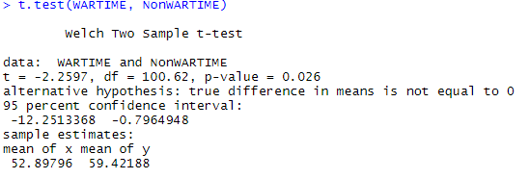
Do “wartime” president's approval ratings differ from non wartime presidents?
Null: Ho; wartime presidents have the same mean approval ratings as non-wartime presidents
Alternative: H1; Wartime presidents do not have the same mean approval rating than non-wartime presidents
Conclusion: failure to reject the null and accept the alternative hypothesis that wartime presidents do not have the same mean approval rating than non-wartime presidents.

